Slide 1
Resets, sys.init, Clocks, Interrupts, Timers
(Board: MSP430FR6989)
Notes:
sys.init is system initialization

Slide 2
Review of Previous Classes
#include <driverlib.h> vs #include <msp430.h>
Setting up a CCS project to use driverlib.h
GPIOs
Notes:
Revision of last class

Slide 3
We’d go through…
Operating modes & Resets(BOR, POR, PUC, AM)
Clocks and types
Watchdog timer
DCO setup and initialization
Interrupts
Quiz time?
Using the clocks.

Slide 4
INTERRUPTS!
Notes:
Here we used a simple example of checking your whatsapp while work is going on. You either wait for a notification before checking your phone or you keep checking it in anticipation.
We can then say we’d get back to this since our code uses interrupts.
Grouped ISR on Design Workshop page 242.
Grouped ISRs are why we have the __even_in_range(TA0IV,14) kind of functions. Our code figures which flag has been set.

Slide 5
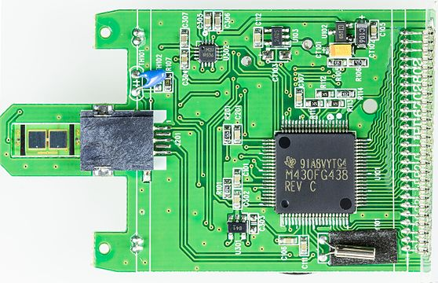

Operating Modes
TASK
Let’s talk about operating modes from the user guide. Go to page 48.
Aktivmed Glucocheck runs on two 1.5V AA batteries.
Notes:
I show this photo since its important for a device like this to manage power when in standby mode.

Slide 6
Where Do Resets Come from ?
TASK
Go to page 38 of MSP4306989 user guide for reset overview
Go to page 79 of MSP4306989 datasheet for specific reset sources.
Acronyms just in case you’re stuck.
FRCTL –FRAM controller
PMM –Power Management Module
WDT –Watchdog Timer
MPU –Memory Protection Unit
Notes:
Page 38 to talk about what causes the types of resets
Page 79 shows flags that can cause resets

Slide 7
Tick-Tock Goes the Clock.
TASK 1
Go to page 87 of MSP430FR6989 user guide for clock system block diagram.
TASK 2
Let’s find the clock on the board and figure out which pins it is connected to.
What are the types of clocks we have all together?
ACLK
MCLK
SMCLK
VLOCLK
LFXTCLK
MODCLK
LFXT
HFXT
VLO
DCO
MODOSC
LFXTCLK
HFXTCLK
VLOCLK
DCOCLK
LFMODCLK
1/2/4/8
SIGNAL GENERATED
DIVIDER
HARDWARE
INTERNAL DEVICE SIGNAL
Notes:
Page 87 to show the clock system and parts
Then we can trace which pins the clock is connected to on the board. I downloaded the board’s circuit diagram to find out.

Slide 8
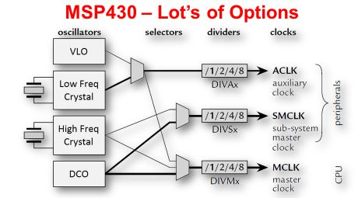
Notes:
A simpler look explained

Slide 9
So What Clocks Do You Need?
Fast Clocks CPU, Communications, Burst Processing
Low-power RTC, Remote, Battery, Energy Harvesting
Accurate Stable over ⁰/V, Communications, RTC, Sensors
Failsafe Robust–keeps system running in case of failure
Cheap … goes without saying …
… or some combination of these features?

Slide 10
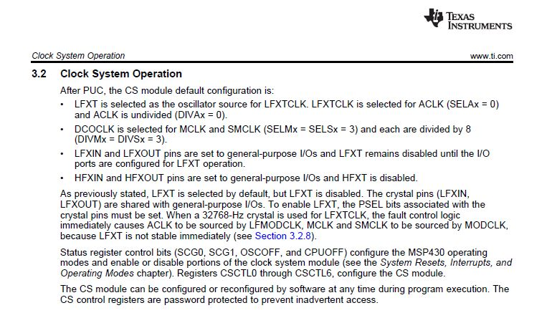
And What Happens to the Clocks After a Reset?
Notes:
1. What we should keep in mind about the clock system: the clock pins default to IO

Slide 11
So Now What with the Clocks?
Set up timer A to first use the on-board 32.768kHz clock to blink LED
Set up timer A to use internal DCO at 1MHz to blink LED
Configure GPIO for the LEDs
Notes:
Here we talk about how we’d apply the clocks in the practice codes.

Slide 12
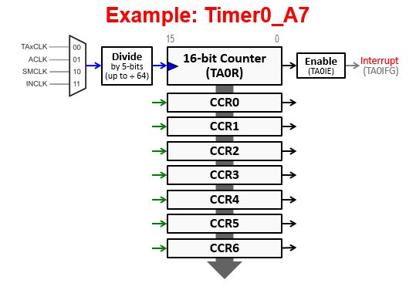
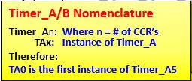
Timers/Counters!
TASK
Go to page 3 of MSP430FR 6989 datasheet to see timer.
Let’s understand the nomenclature
THINGS TO KNOW ABOUT TIMERS ON MSP430 FOR THE PROJECT
3 Timer modes: continuous, up-down, up
Multiple Capture/Compare registers
Notes:
Capture registers grabs the value of a timer at an instance of time..
Compare registers hold a value and timer pending an event or for some other purpose.

Slide 13
4 Steps to Program Timer_A
Timer Setup Code
Configure Timer/Counter (TACTL)
Clocking
Which Count Mode
Interrupt on TAR rollover?
Setup Capture and/or Compare Registers?
Clear interrupt Flags & Start Timer
Write ISR.
Timer_A Ctrl Reg (TACTL)
16-bit Counter (TAR)
CCR0 Ctrl Reg (TACCTL0)
CCR0 (TACCR0)
.
.
.
CCR6 Ctrl Reg (TACCTL6)
CCR6 (TACCR6)
Notes:
The step is also similar for Timer B. Timer B can do what Timer A can but it’s not exactly the same in reverse. They have similar functions though, except the little extra of Timer B. In the example code, Timer B was used like a normal timer like Timer A.

Slide 14
Code Time!
Do you really need to know about thermodynamics and internal combustion engines to drive a car? Driverlib helps us get things done faster without knowing all the details.
TASK 1.
How do you think we would get this blinky project done? Let’s chat about the algorithm.
Open up CCS and blink the LED with timer and interrupt.
Change the clock source and check the difference.
Use different clock sources for different timers to blink the two LEDs separately
.
But we need to setup CCS to use driverlib first!
Notes:
Engage users in their thoughts on how we could blink the LEDs
Let them try the code to blink the LEDs
Let them try using different clock sources to see how clock speed affects blink rate
Then we explain how we simply looked at the codes in the driverlib to figure out which functions and their parameters to use.

Slide 15
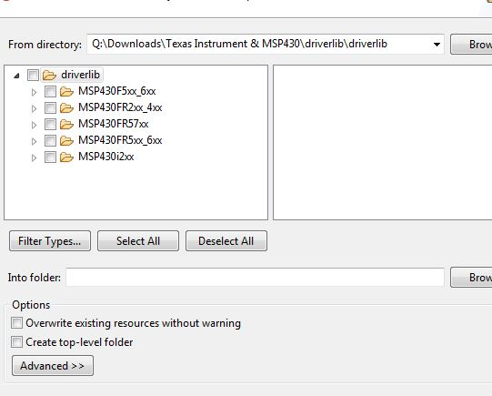
Setting up CCS to Use <driverlib.h>
Where the chip-specific folder is on my PC.
Take note of where you have the driverlib folder on your computer
Go file -> import -> general -> file system , then browse to the driverlib folder and press OK. Then select your chip-specific folder like it is in this picture.
In the ‘Into folder’ entry box, browse to your active project.
Click finish to…well, finish.

Slide 16
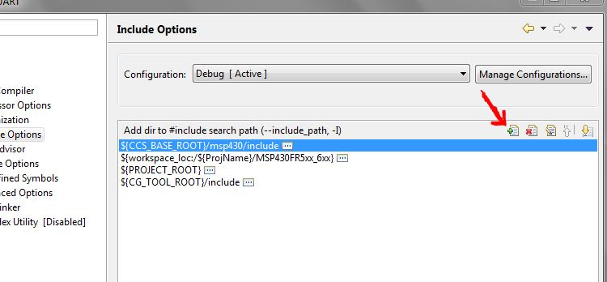
Setting up compiler path for #include <driverlib.h>
In the tab on the upper side of the screen go to Project -> Properties -> Build -> MS430 Compiler -> Include Options
Then click add, then workspace, then browse to MSP430xx folder you imported earlier.

Slide 17

Watchdog Timer

Slide 18
A little about the Watchdog Timer
Go to page 420 of family user guide for the introduction
Run the Watchdog in timer mode and see what happens
Notes:
1. Page 420 says what the timer is for and its extra features
2.Nothing will happen in watchdog mode. We then explain that timer expiration causes a PUC that doesn’t hurt our LEDs so much except reset the CPU. It all happens in a flash.

Slide 19
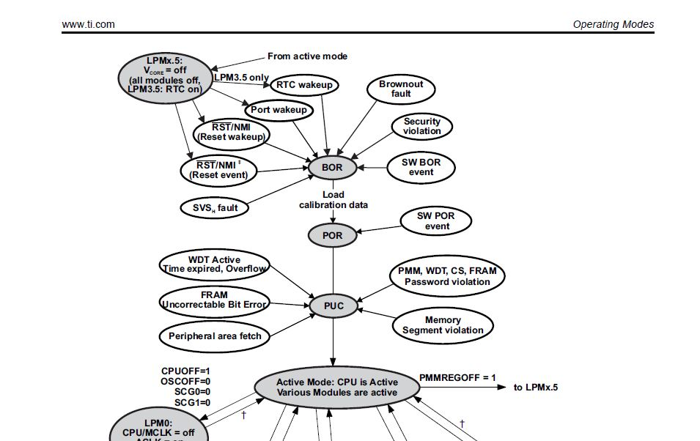
Go to page 47 of user guide for explanation
Notes:
We explain how the watchdog sets everything back to default and turns off all low power modes.
We could ask about the reset method of the chip in MEMMCOL meters.

Slide 20
Watchdog in Timer Mode
Run the code set for timer mode and see for yourself. Interrupts also used.
Notes:
We use the watchdog as a timer to blink LEDs

Slide 21
THE END

